Slide 1
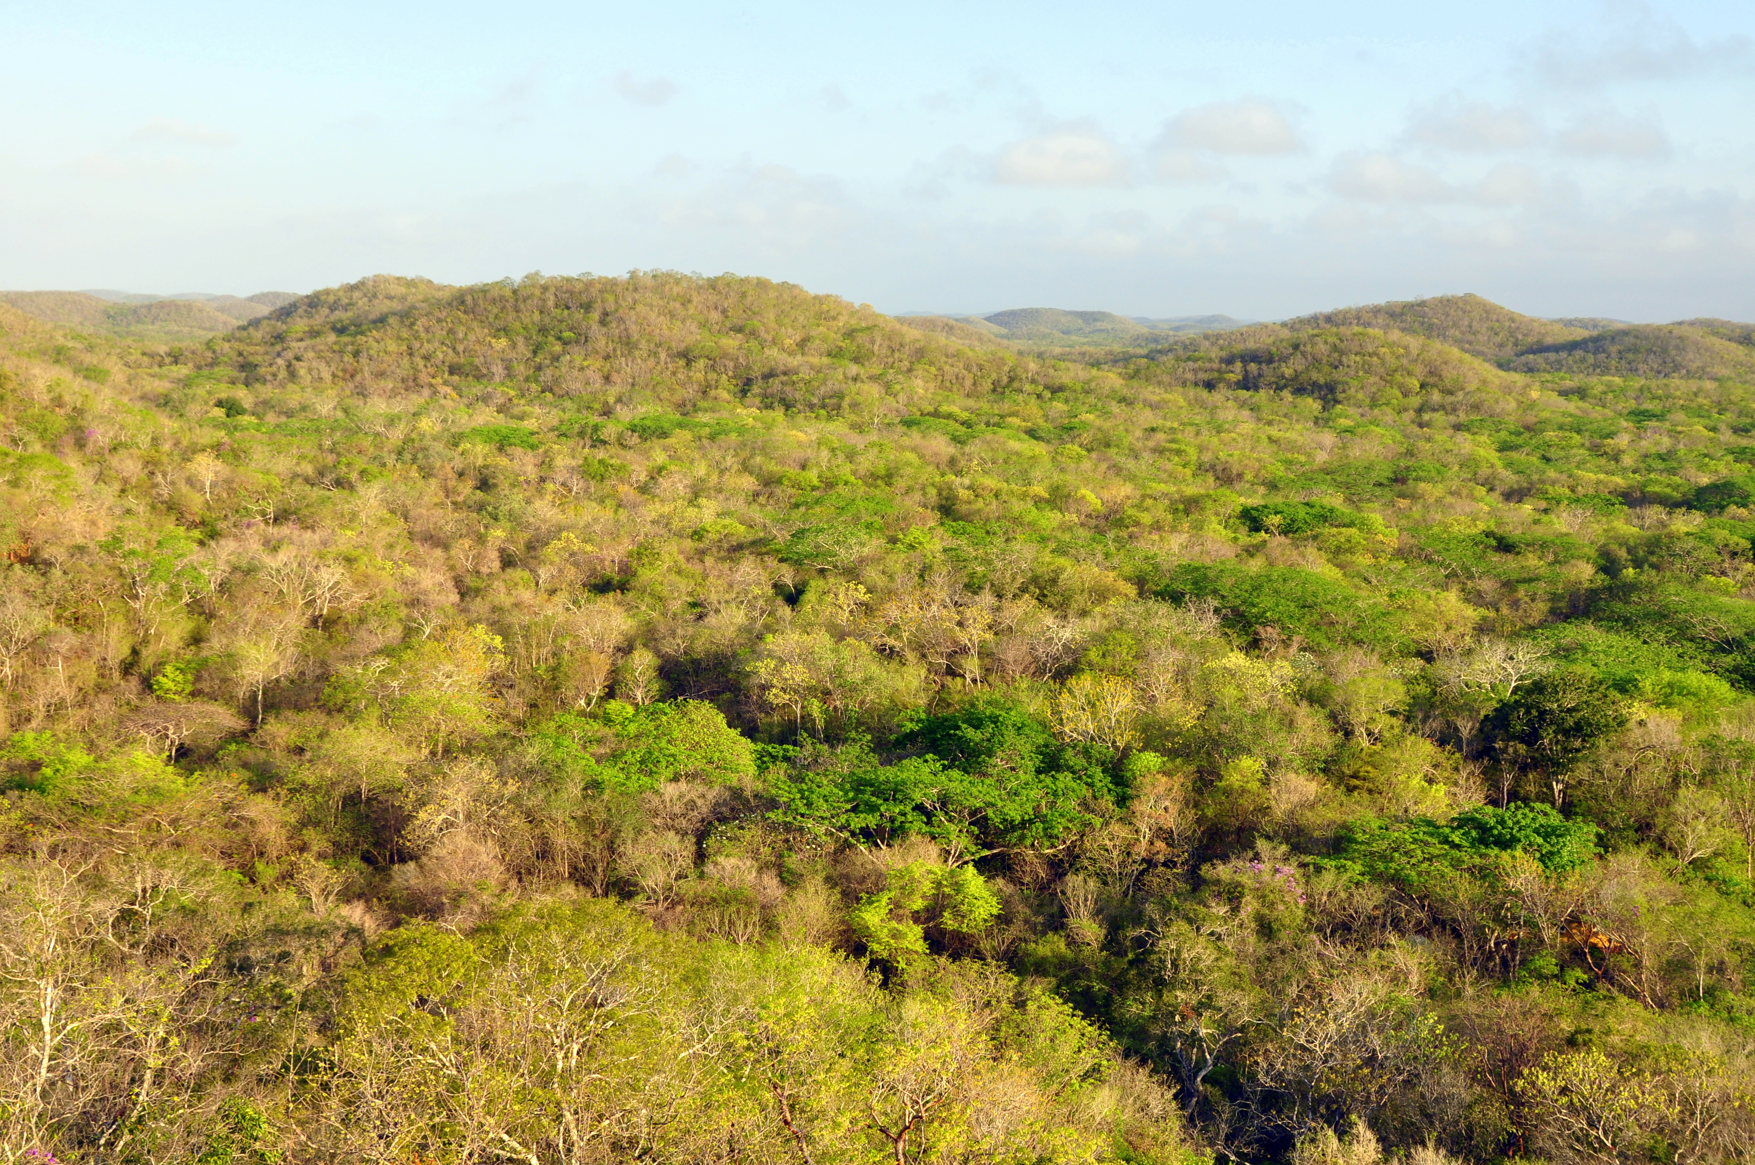
Direct Measurement of Aboveground Carbon Dynamics
In Support of Large Area CMS Development
Wayne Walker¹, Alessandro Baccini¹, Curtis Woodcock², Luis Carvalho², Alicia Peduzzi³,
Fabio Gonçalves⁴, Javier Corral Rivas⁵, Carlos Lopez Sanchez⁵
Geospatial Data Integration for
Forest Carbon Monitoring:
Southeast Mexico and Beyond
Titulo de la presentación
Motivation: Conventional approaches to forest carbon emissions estimation (i.e., IPCC) tend to be characterized by high uncertainty…
Herold et al. 2011
Overall Goal: Demonstrate the potential for annual changes in aboveground carbon density (ACD) of forests to be estimated directly, consistently, and with quantified uncertainty at subnational to national scales.
Specific Objectives: Quantify the certainty with which extensive field, off-the-shelf airborne LiDAR, and NASA satellite data can be used synergistically to estimate wall-to-wall changes in ACD for the country of Mexico:
MODIS: 15-years (2001-15) @ 500 m nationally
VIIRS: 5-years (2012-16) @ 375 m nationally
Landsat: 15-years (2001-15) @ 30-300 m subnationally
Independent accuracy assessment of Objectives 1-3

Slide 2
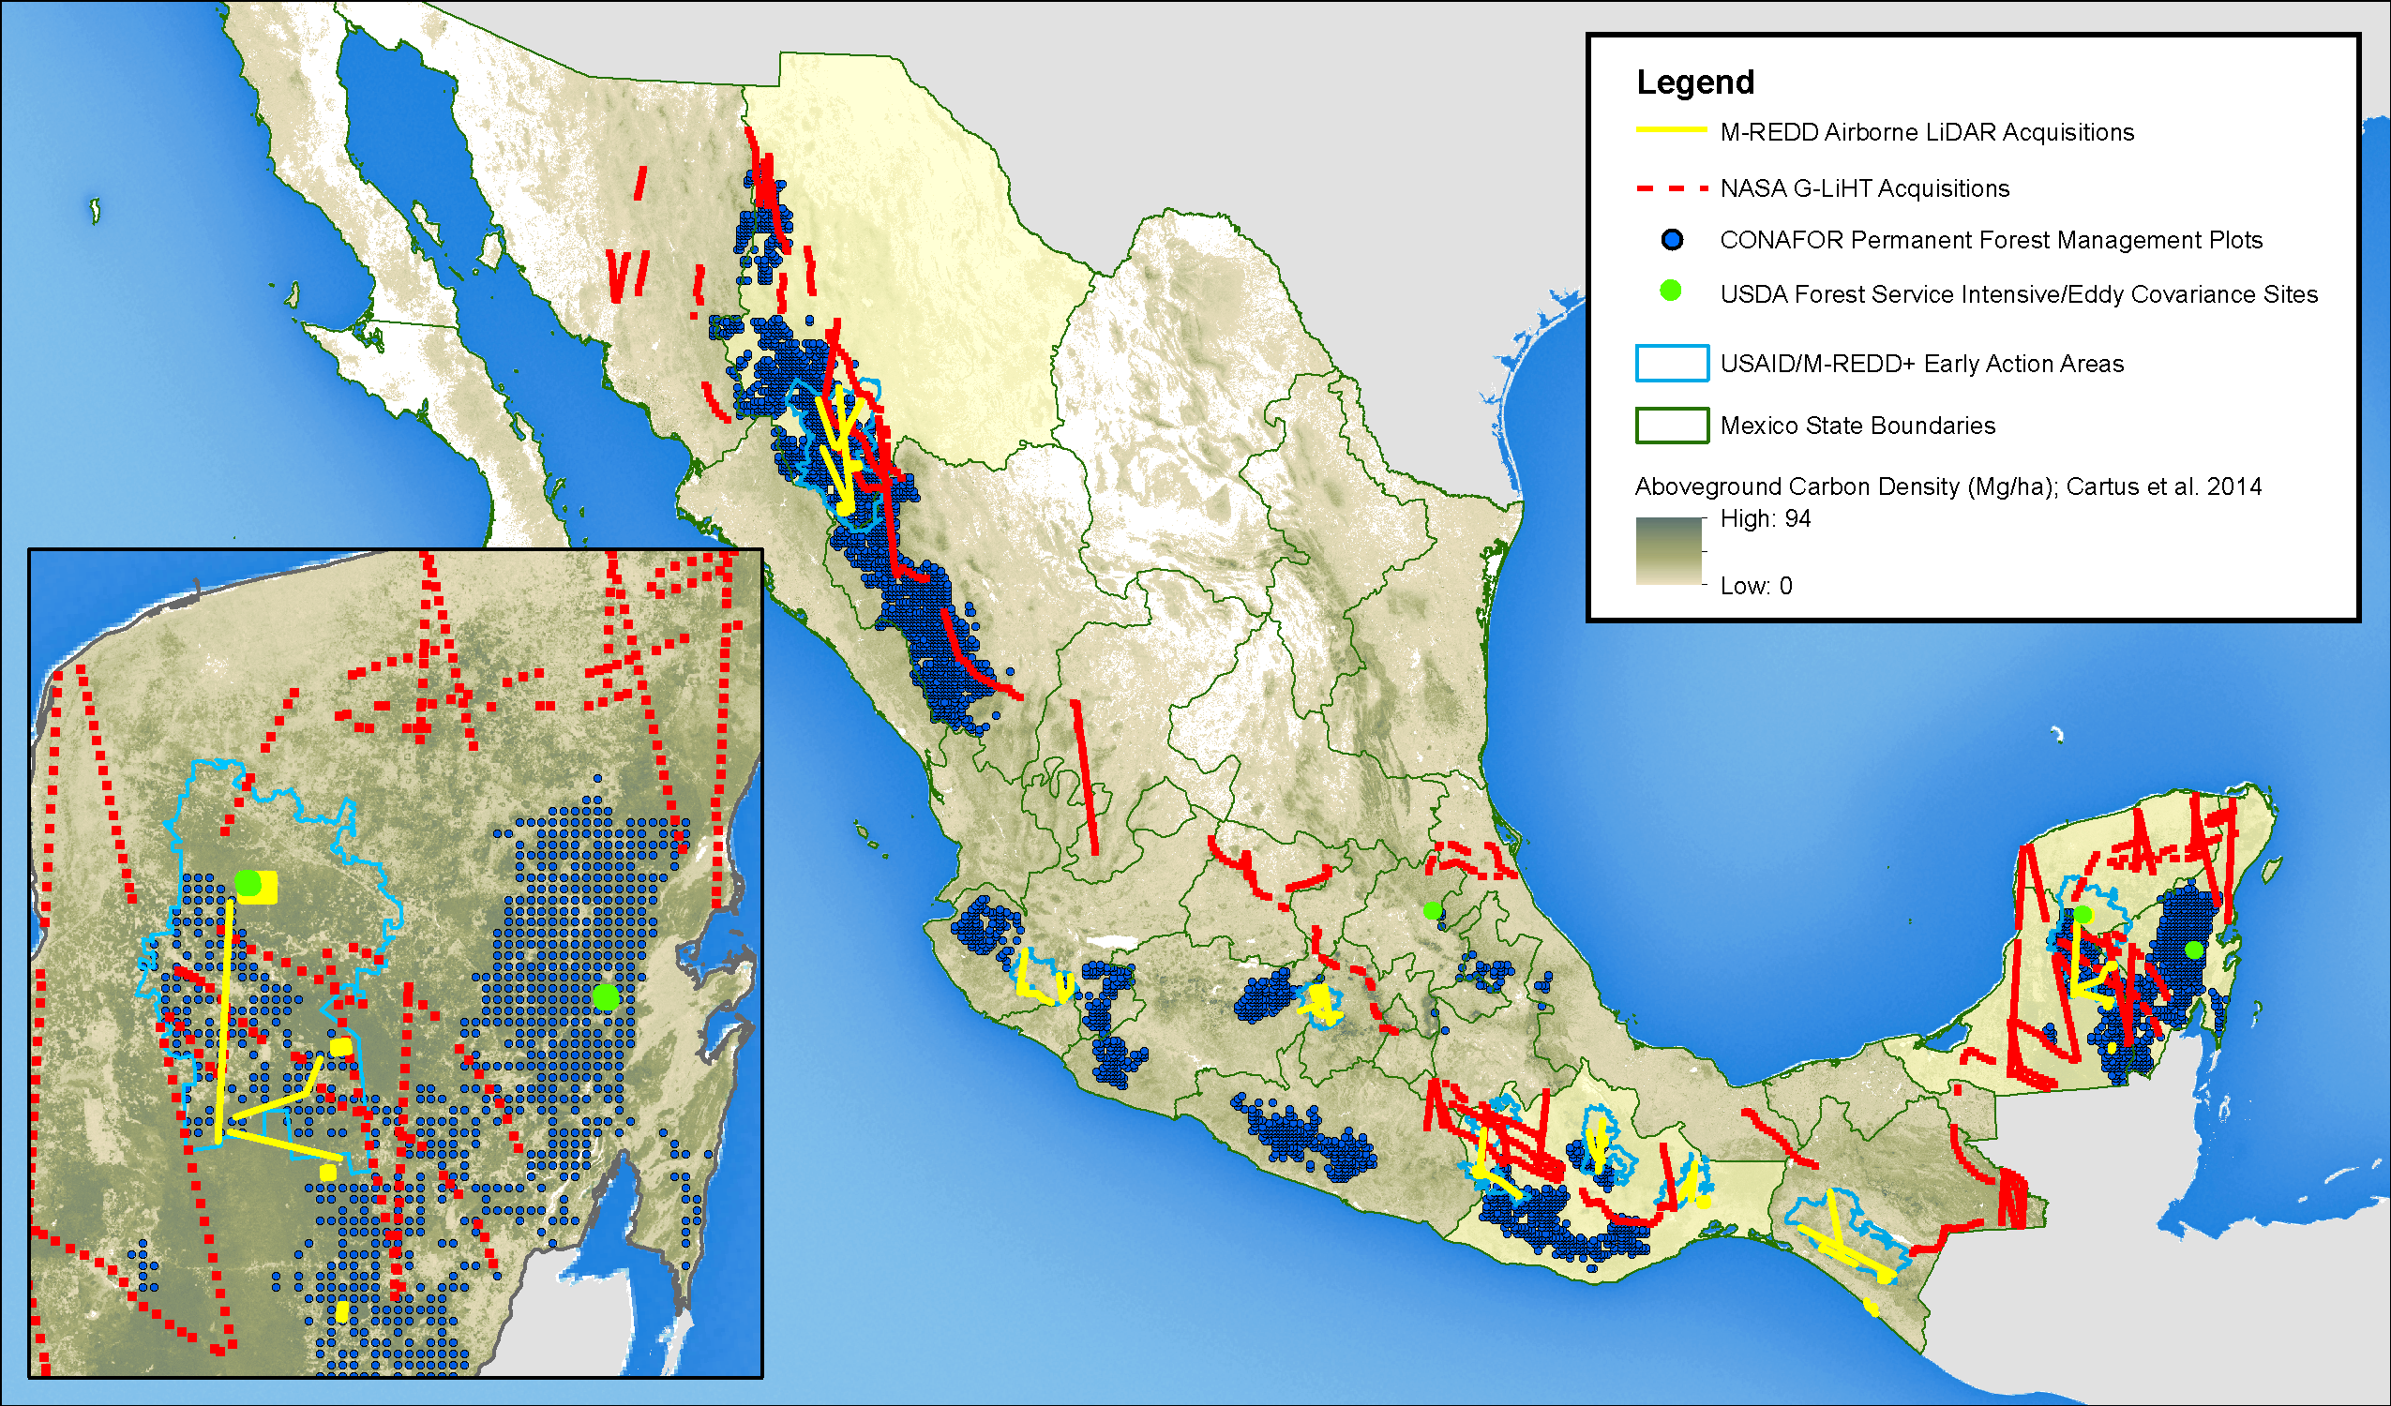
Direct Measurement of Aboveground Carbon Dynamics
In Support of Large Area CMS Development
Wayne Walker¹, Alessandro Baccini¹, Curtis Woodcock², Luis Carvalho², Alicia Peduzzi³,
Fabio Gonçalves⁴, Javier Corral Rivas⁵, Carlos Lopez Sanchez⁵

Slide 3
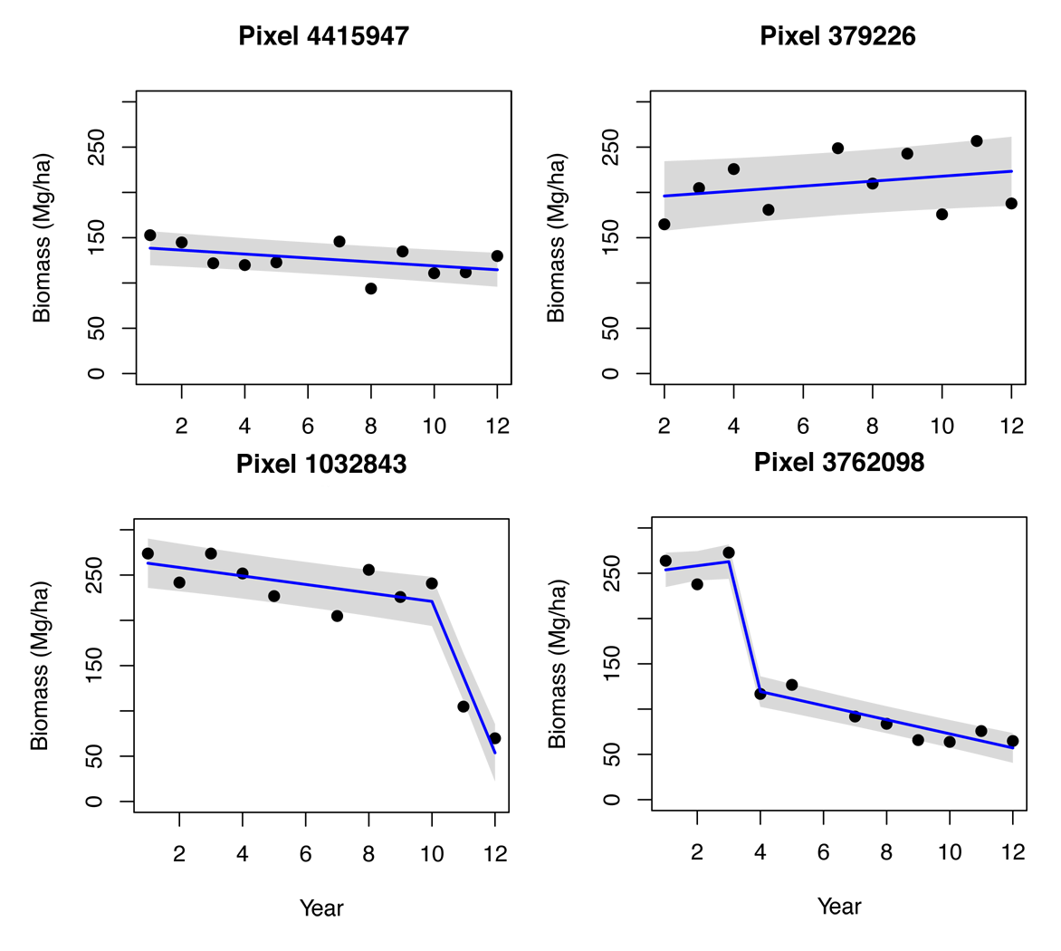
Direct Measurement of Aboveground Carbon Dynamics
In Support of Large Area CMS Development
Wayne Walker¹, Alessandro Baccini¹, Curtis Woodcock², Luis Carvalho², Alicia Peduzzi³,
Fabio Gonçalves⁴, Javier Corral Rivas⁵, Carlos Lopez Sanchez⁵
Geospatial Data Integration for
Forest Carbon Monitoring:
Southeast Mexico and Beyond
Titulo de la presentación
Baccini et al. 2012
Time Series Biomass
Mapping
2001
Pixel-level Change Point Analysis
2012

Slide 4
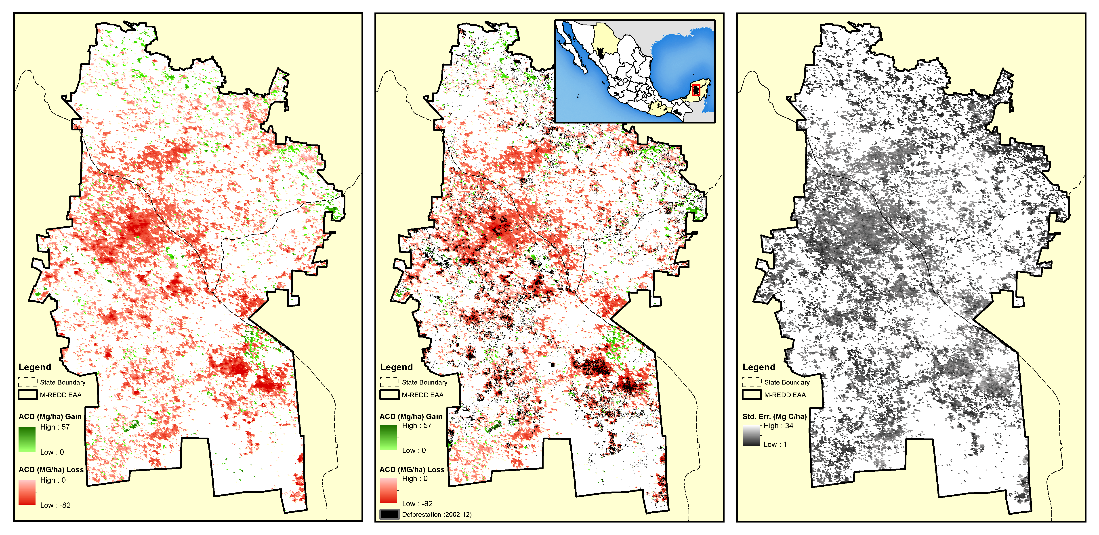
Direct Measurement of Aboveground Carbon Dynamics
In Support of Large Area CMS Development
Wayne Walker¹, Alessandro Baccini¹, Curtis Woodcock², Luis Carvalho², Alicia Peduzzi³,
Fabio Gonçalves⁴, Javier Corral Rivas⁵, Carlos Lopez Sanchez⁵
Geospatial Data Integration for
Forest Carbon Monitoring:
Southeast Mexico and Beyond
Titulo de la presentación
2001-2012
2001-2012
2001-2012

Slide 5
Direct Measurement of Aboveground Carbon Dynamics
In Support of Large Area CMS Development
Wayne Walker¹, Alessandro Baccini¹, Curtis Woodcock², Luis Carvalho², Alicia Peduzzi³,
Fabio Gonçalves⁴, Javier Corral Rivas⁵, Carlos Lopez Sanchez⁵
Geospatial Data Integration for
Forest Carbon Monitoring:
Southeast Mexico and Beyond
Titulo de la presentación
Thank you!

